Slide 1
Echoes beneath : a Single player adventure game pickled rat ani, murray, harvey, vinh, chongsheng, shayaan

Slide 2
elevator pitch
Stranded on an alien ocean planet, you are forced to escape the remnants of your space craft in the only surviving submarine escape pod and explore the uninhabited territory.
Under the sea you will face a myriad of alien marine life and travel through dangerous terrain in darkness. Pilot a submarine, evade deadly creatures, and uncover the mysteries of the deep.
With only the help of the malfunctioning sonar systems, can you traverse blind through murky currents and find your way to safety.

Slide 3
Flagship tech
Simulation of sonar (soundwaves) using Ray-traced Audio
The submarine uses sonar to detect nearby objects and terrain
Use ray-tracing to simulate the paths of sound as it travels through water and interacts with the environment
Active sonar (player emits soundwaves and the computer system analyzes the return)
Passive sonar (player detects soundwaves emitted by environment)
Generate an estimated 3D echolocation map of close quarters environment

Slide 4
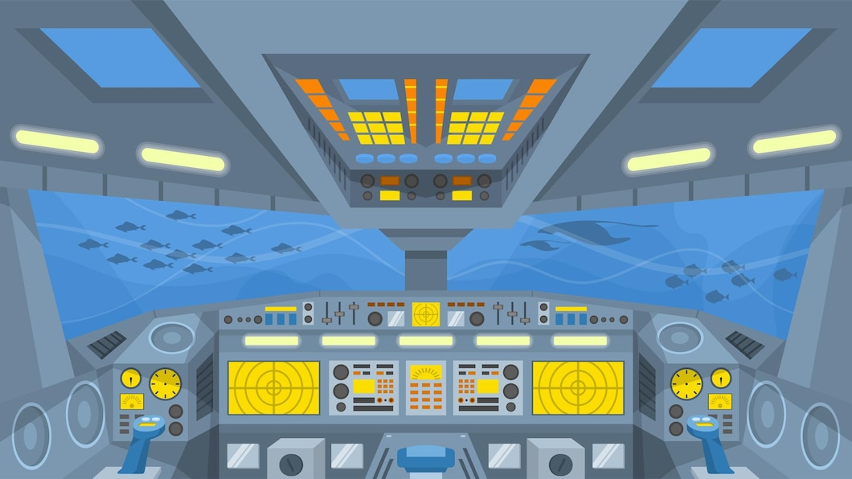
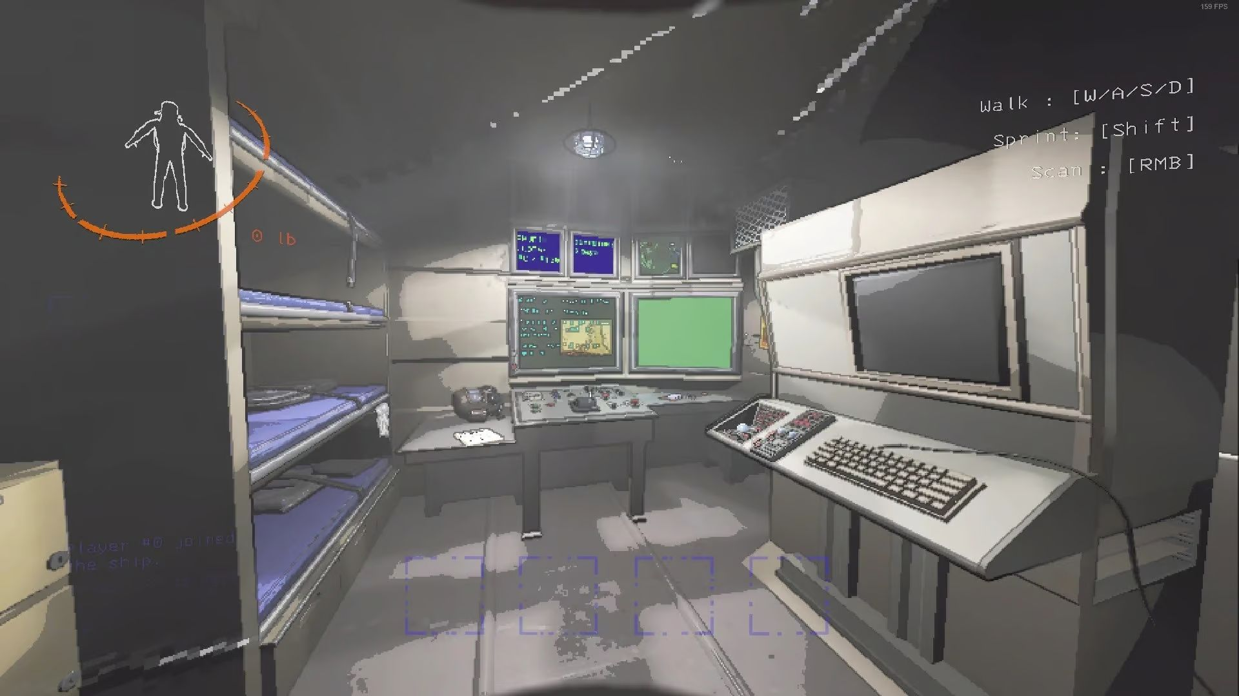
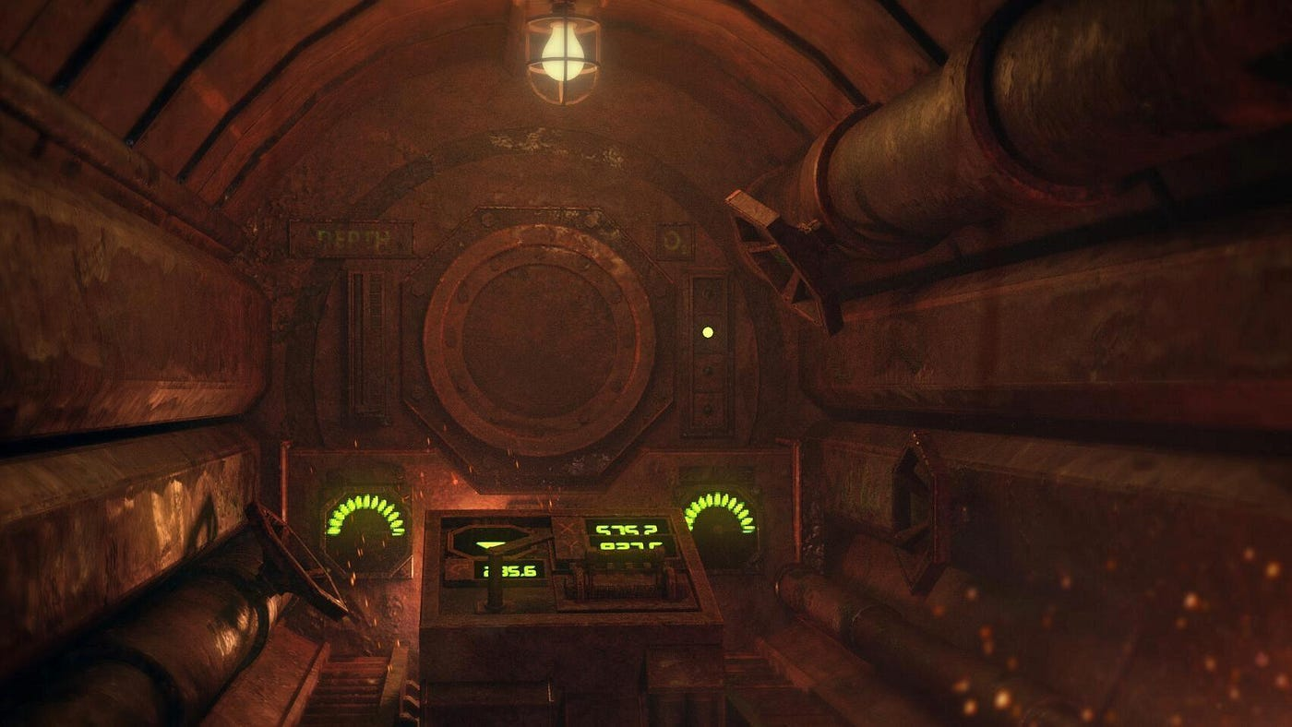
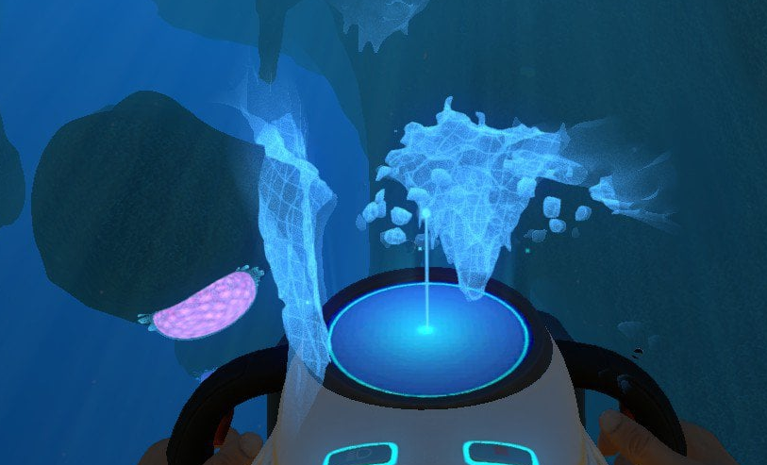
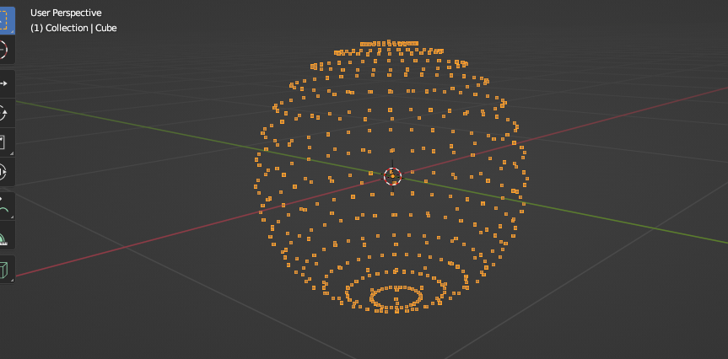
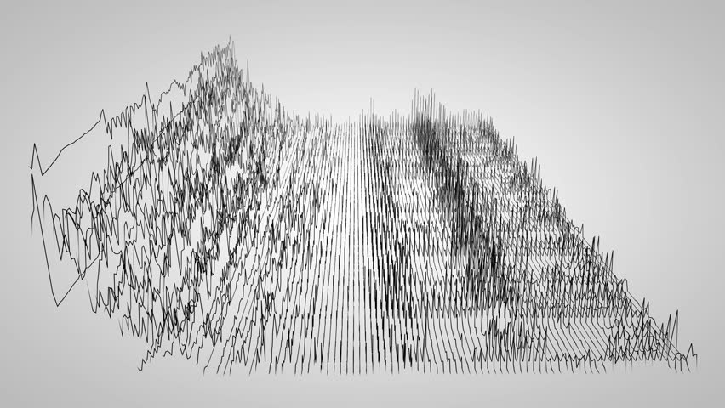
Art & Design
Simple 3D graphics of inside the cockpit similar to a combination of:
3D generated echolocation map of close surroundings with effects like:

Slide 5
Gameplay
Story: Your spaceship has been damaged by a meteorite…
Your goal is to survive this new uncharted alien planet
Survival: Players need to survive in the territory full of danger, such as natural minefields, narrow terrains and unexpected sealife.
Exploration: Players are also in a world full of resources, which are used to survive and repair
Detection: Players make use of sonar to detect nearby objects, by combining observation on the sonar panel and listen carefully. When objects are close enough, objects can be detected by searchlight.
Rare resources found to fix sub, make utilities and fulfil survival needs
Equipment: Steering, Sonar, Enhanced sonar for 3D map, distractions, claw to grab resources

